Slide 1
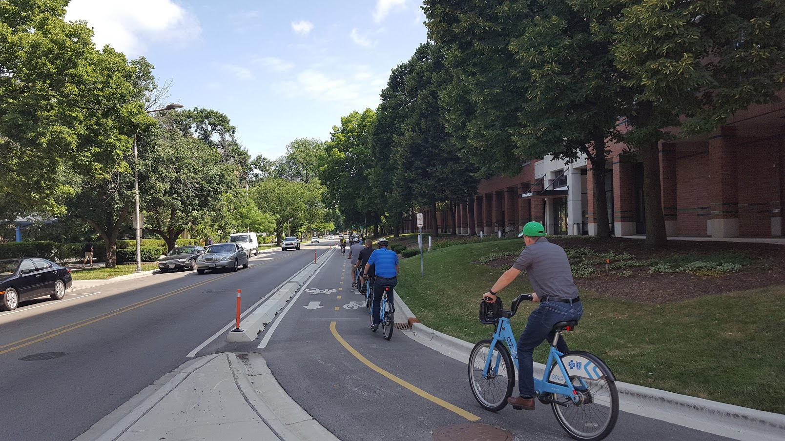
Bicycle Design Gudelines
Urban + Suburban Applications
October 11, 2019

Slide 2
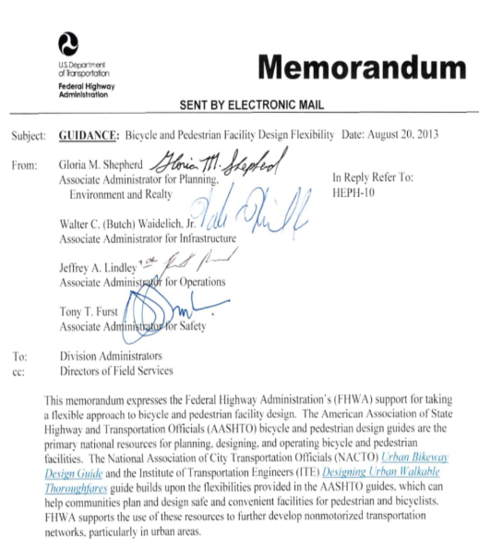
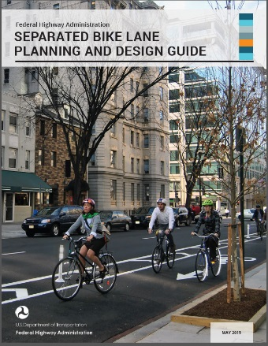
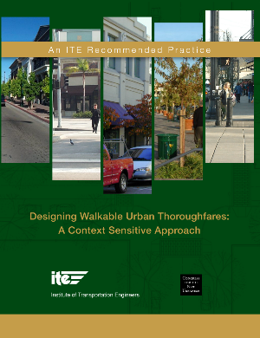
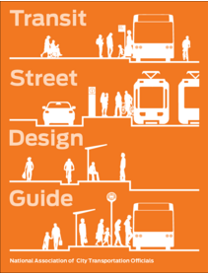
POLICY
Notes:
Add logos to explain the cyclical relationship
FHWA Policy Memos
2010, encourage flexibility
2013, mentions ITE, AASHTO, and NACTO by name

Slide 3
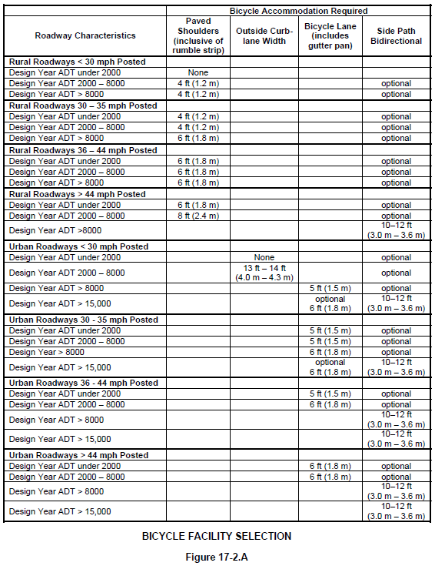
Policy
IDOT BDE, Chapter 17
17-1.05 Maintenance and Jurisdiction
17-1.07 Funding
IDOT BLRS, Chapter 42
42-3.02(a) Bike Paths Versus Sidewalks
42-4 Maintenance
POLICY
Notes:
17-1.05 Maintenance and Jurisdiction
Responsibility for ongoing maintenance of bikeway facilities within the roadway surface is assumed to be an integral part of roadway maintenance. Responsibility for maintenance of bikeway and pedestrian facilities separated from the roadway surface should be delegated by agreement with local/State jurisdictions or others early in the planning process; see Chapter 5.
17-1.07 Funding
Bicycle facilities for the safe travel of bicyclists within an improvement corridor, are considered an integral part of a highway project for funding purposes, and thus are eligible for cost participation as discussed in Chapter 5. If conditions within the roadway prohibit the inclusion of adequate bicycle accommodations, necessary off-roadway accommodations shall be included where they can be accommodated. Accommodations beyond those that are determined necessary from the Facility Selection Table in Figure 17-2.A may be desired or preferred by local officials, and the cost difference could be funded through several options as follows:
- initiated by others than IDOT and submitted as a candidate for the Transportation Enhancement Program funding (see Chapter 18);
- initiated by others than IDOT and submitted for consideration from other appropriate Federal funding categories (e.g., the Congestion Mitigation and Air Quality (CMAQ) or various Surface Transportation Program (STP) categories); or
- initiated by others than IDOT and funded entirely through outside governmental organizations.
42-4 MAINTENANCE
Responsibility for maintenance of bike lane facilities should be determined and agreed upon during the planning process and should be included in the local agency funding agreement, when applicable.

Slide 4
POLICY
Notes:
FHWA provides guidance on the status of approved traffic control devices per MUTCD
“As described in Paragraph 11 of Section 1A.10, all requests should include…”

Slide 5
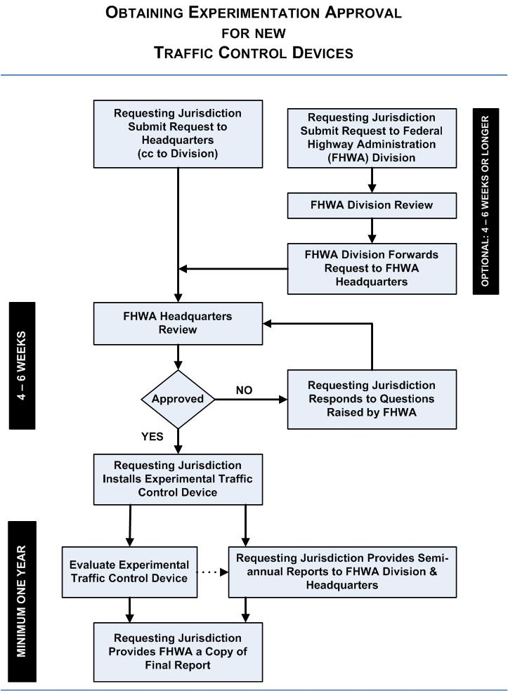
MUTCD 1A.10 Experimentations, Changes, and Interim Approvals
Approved
Acceptable for use as indicated
Interim Approval
Notify FHWA to document your intent
Item is likely to be included in next MUTCD, but rules may be revised
Request to Experiment
MUTCDofficialrequest@dot.gov
Statement of interpretation
Description of condition that provokes need
Illustrations and diagrams as needed
Pertinent supporting research data
POLICY
Notes:
FHWA provides guidance on the status of approved traffic control devices per MUTCD
“As described in Paragraph 11 of Section 1A.10, all requests should include…”

Slide 6
Principles
Make it rideable
Make it inviting, comfortable
Make roadway users visible to each other
Design for all ages and abilities
Context matters
PRINCIPLES
Notes:
Rideable: smooth riding surface, no potholes, drainage grates should run perpendicular to the path of travel, don’t let manholes or vault covers protrude/recess
Inviting, comfortable: give adequate space and designate space exclusively for bicyclists, prevent speeding, reallocate roadway space, change land widths if needed
Aware/visible: make it easier for people driving to see people bicycling and vice versa – this is where geometry is key and pavement markings/signs can help
All ages and abilities: too stressful to take your child with you? Keep thinking about what would further reduce stress.

Slide 7
Principles
Metrics
Level of Service (LOS/BLOS)
Level of Traffic Stress (LTS/BLTS)
Who is the Bicycling Population?
Number of Lanes
Traffic Speed
Volume/Type
Exclusive Space
Facility Width
Buffers/Barriers
Image Source: Fehr & Peers, one.jack.design
PRINCIPLES
Notes:
LTS is a qualitative measure that evaluates the level of stress a bicyclists feels when using a facility
- Inputs are quantifiable
- Stress tolerance tracks closely with confidence and experience level

Slide 8
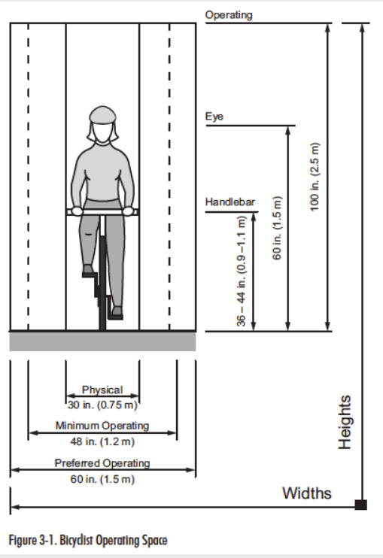
Principles
Basics: Operating Width
4’ minimum
5’ preferred
Additional separation needs will vary (buffers, curbs, bollards, flexposts/delineators, parked cars, medians)
PRINCIPLES
Notes:
Rideable: smooth riding surface, no potholes, drainage grates should run perpendicular to the path of travel, don’t let manholes or vault covers protrude/recess
Inviting, comfortable: give adequate space and designate space exclusively for bicyclists, prevent speeding, reallocate roadway space, change land widths if needed
Aware/visible: make it easier for people driving to see people bicycling and vice versa – this is where geometry is key and pavement markings/signs can help
All ages and abilities: too stressful to take your child with you? Keep thinking about what would further reduce stress.

Slide 9
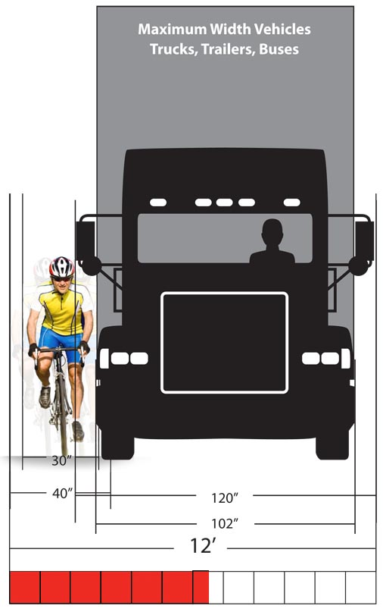
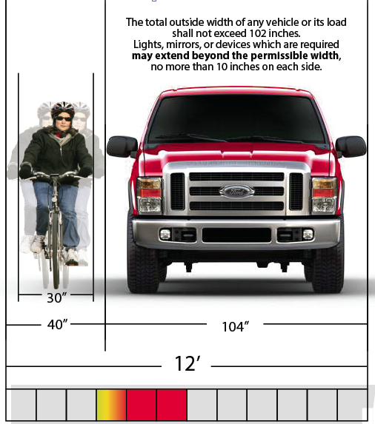
Image Source: Kery Caffrey, Cycling Savvy
PRINCIPLES
Notes:
Rideable: smooth riding surface, no potholes, drainage grates should run perpendicular to the path of travel, don’t let manholes or vault covers protrude/recess
Inviting, comfortable: give adequate space and designate space exclusively for bicyclists, prevent speeding, reallocate roadway space, change land widths if needed
Aware/visible: make it easier for people driving to see people bicycling and vice versa – this is where geometry is key and pavement markings/signs can help
All ages and abilities: too stressful to take your child with you? Keep thinking about what would further reduce stress.

Slide 10
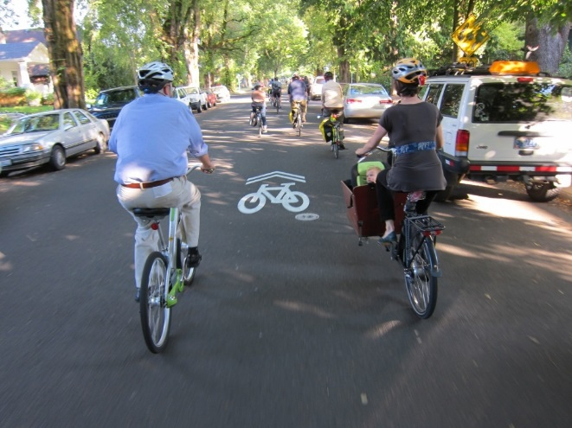
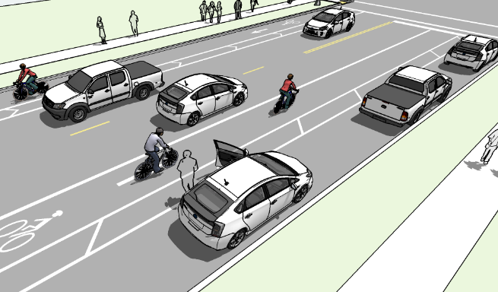
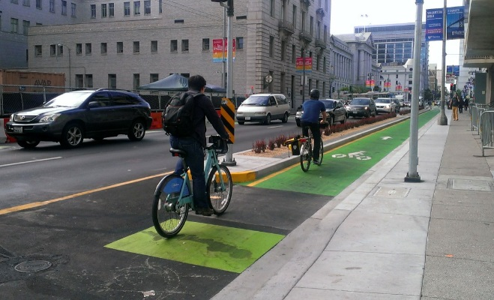
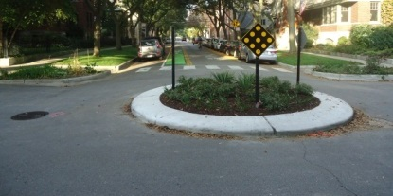
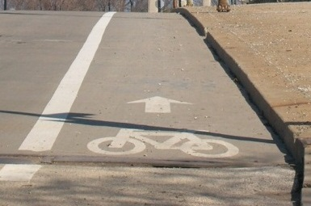
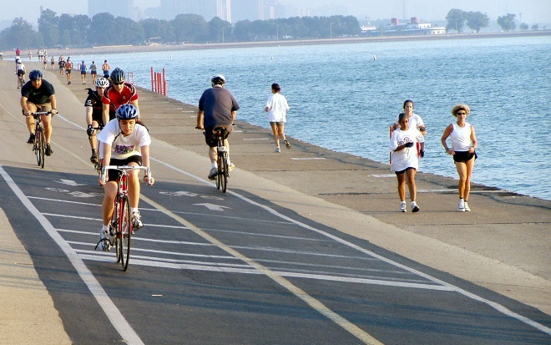
Context Matters
Physical Separation
Traffic Volume
Exclusive Lane Assignment
Shared Spaces
Motor Vehicle Speeds
PRINCIPLES
Notes:
The general breaking points or thresholds vary, but can look something like this:

Slide 11
Management Strategies
Speed
Speed & Volume
Volume
Reduce Lane Width
Speed Hump, Table*
Mini Traffic Circle
Curb Extension
Median Island
Signal Timing
Cul-de-sacs, Diverters
Non-motorized Cut-throughs
Reconfigure Lanes
(Road Diet)
Remove On-Street Parking
PRINCIPLES
Notes:
*Speed bumps, which more often resemble barrier curbs and parking stops, are not ideal for speeds above 5mph and are pretty much universally hated for transportation facilities.

Slide 12
On Street, Midblock
Shared Lane / Yield Roadway
Advisory Shoulder / Advisory Bike Lane
Paved Shoulder
Pedestrian Lane
Bike Boulevard / Neighborhood Greenway
Bike Lane
Buffered Bike Lane
One-Way Separated Bike Lane
Left Side Bike Lane
Contra-flow Bike Lane
Two-Way Separated Bike Lane
Raised, Separated Bike Lane
ON STREET

Slide 13
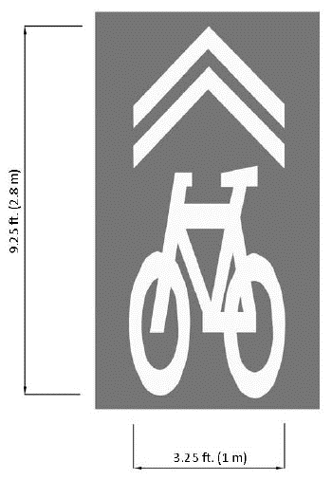
Shared Lane Marking
The “Sharrow”
Shows Intended Alignment of Bicyclist
Visual Reminder of Shared Space
Not intended for use on Bike Lanes or Paved Shoulders
ON STREET

Slide 14
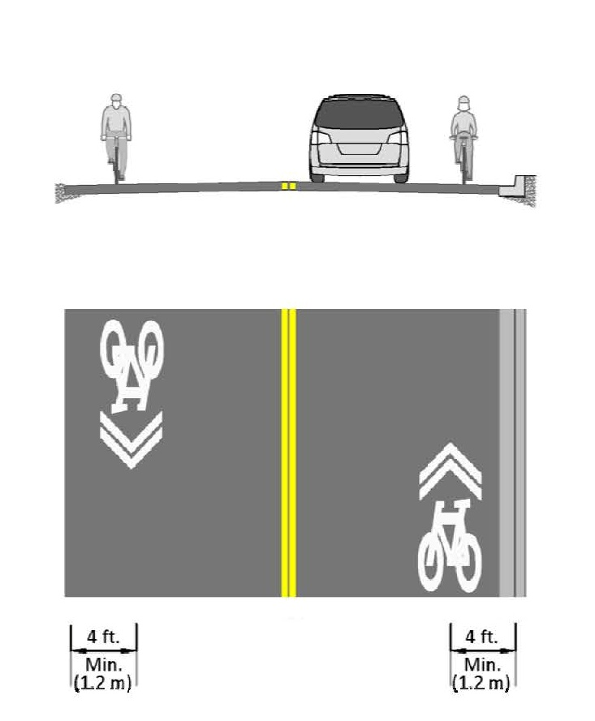
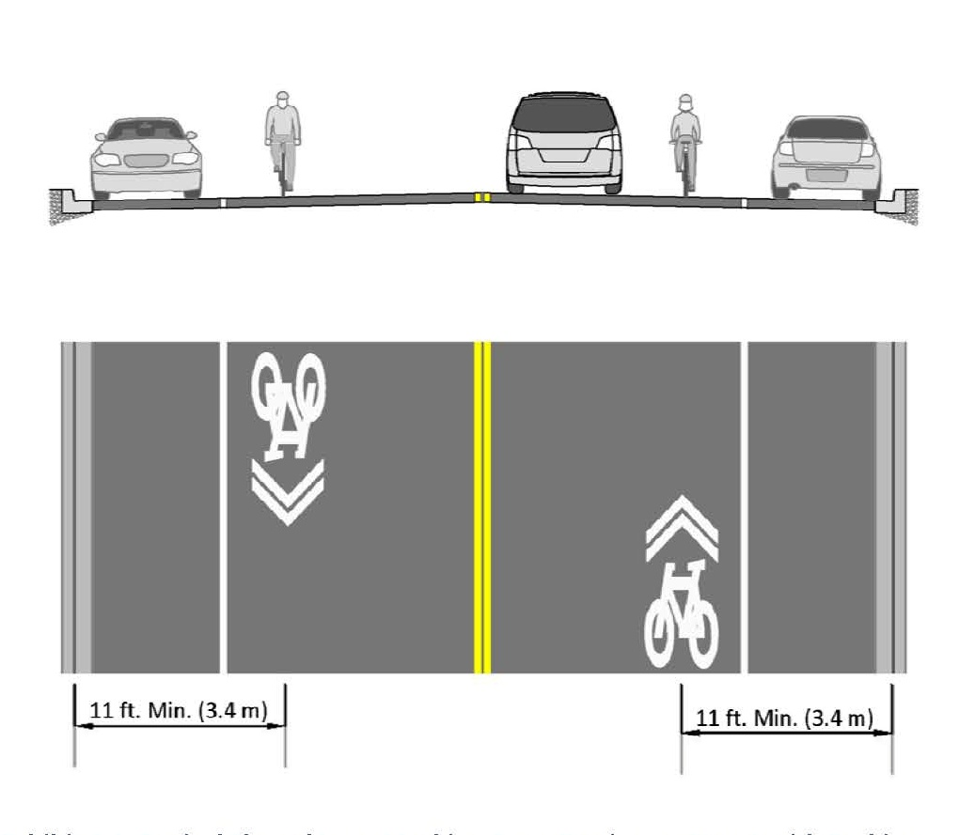
Shared Lane Marking
“For some streets, this may be the center of a shared travel lane.”
– AASHTO Bike Guide, Section 4.4.
ON STREET
Notes:
Generally, these are placed 4’ on center from the face of curb with no parking, or 11’ on center from face of curb when adjacent to parking.
Section 4.4 “For some streets, this may be the center of a shared travel lane.”
High turnover
History of dooring crashes
Or in use on Bike Boulevards

Slide 15
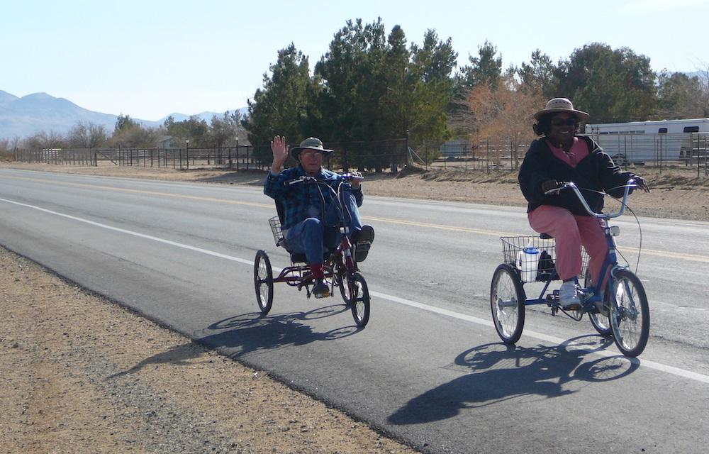
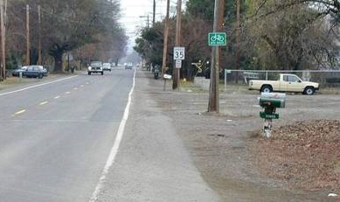
Paved Shoulder
2-4% Cross slope, typ.
BDE/BLRS permits 4-6%, but impractical for bicycling
Helpful on rural/suburban roads
Increases turn radius at intersections
Roadway recovery, room to pull over
Extends pavement life
Snow storage, mail delivery
Key consideration
Maintained by the agency of jurisdiction, unlike a sidewalk or shared use path
Image Source: Alta Planning + Design
ON STREET

Slide 16
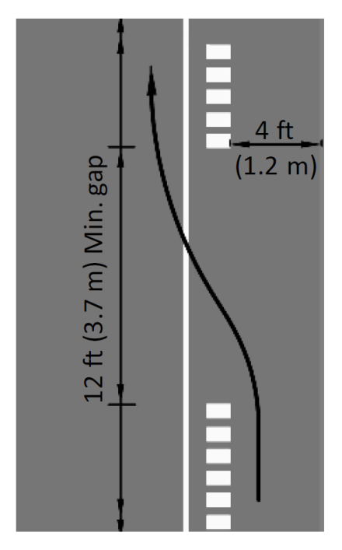
Paved Shoulder
IF you are adding paved shoulders and
IF your design guidance suggests rumble strips
THEN maintain a 4’ min. area between rumble strip and edge of pavement
THEN provide a 12’ gap every 40-60’ for evasive actions
ON STREET

Slide 17
Advisory Bike Lane, Advisory Shoulder
Per AASHTO: 14’+ lane width
Popularized during vehicular cyclist movement
Almost always requires signage
(W11-1 & W16-1 or R4-11)
Better solutions are available
ON STREET

Slide 18
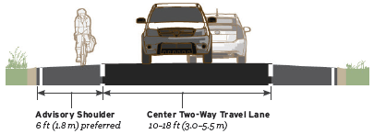
Advisory Bike Lane, Advisory Shoulder
Experimental Treatment
Two-Way Center Travel Lane
No center line
Suitable in Low speed, Low volume Environments
Yield to Bicyclists
Two-way Center Travel Lane
Permissive broken lane line
Optional Contrasting Paving Materials
ON STREET

Slide 19
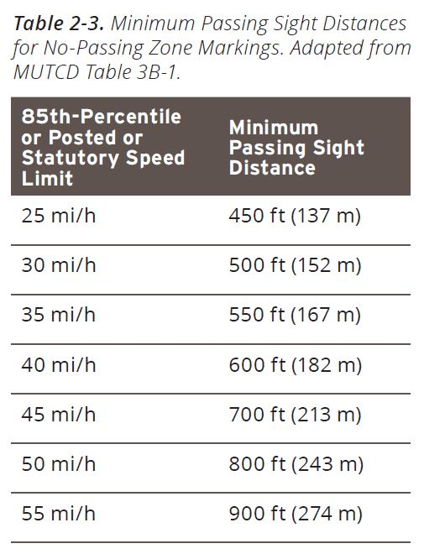
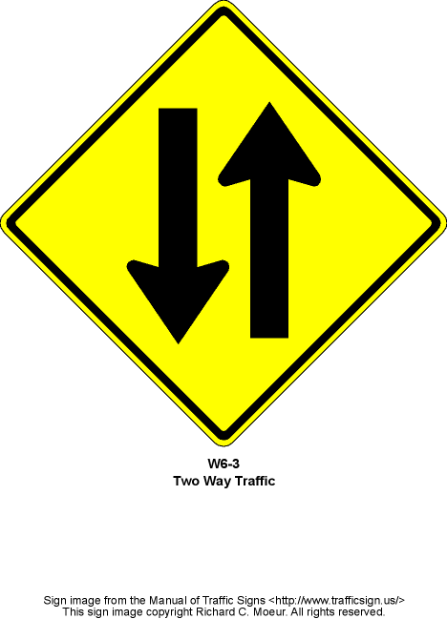
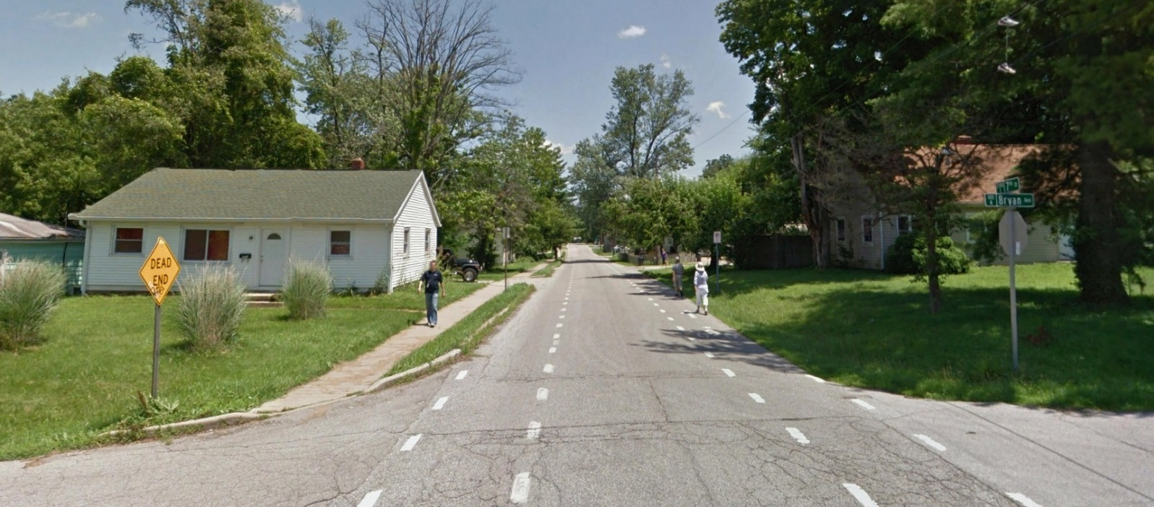
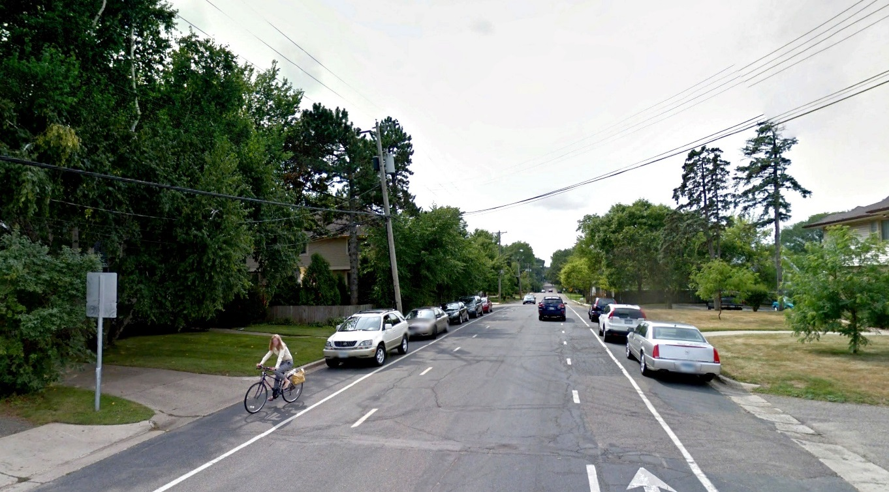
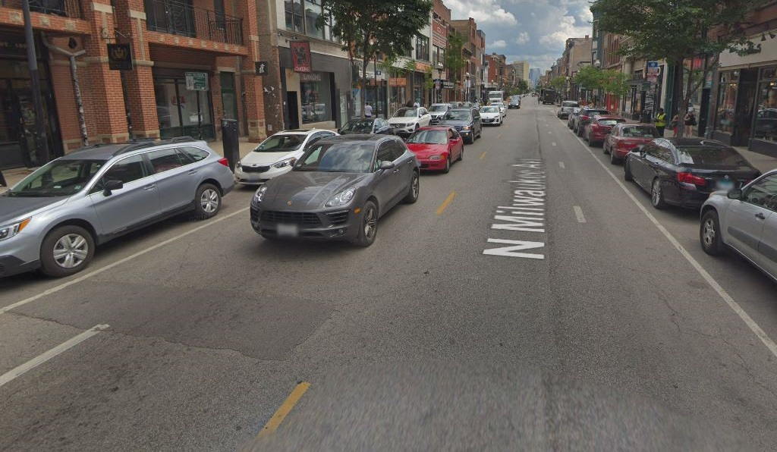
Bloomington, IN
Edina, MN
Chicago, IL
ON STREET
Notes:
Applications can involve curb and gutter or open swale; with or without on-street parking.
FHWA Guidance: Use W6-3 sign to remind users of the two-way condition.
Do not mark a center line.
If you need to mark a center line around a curve, over a hill, or approaching an at-grade railroad crossing, widen the pavement to create paved shoulders and two travel lanes.
Refer to sight distance guidance based on speed from MUTCD.

Slide 20
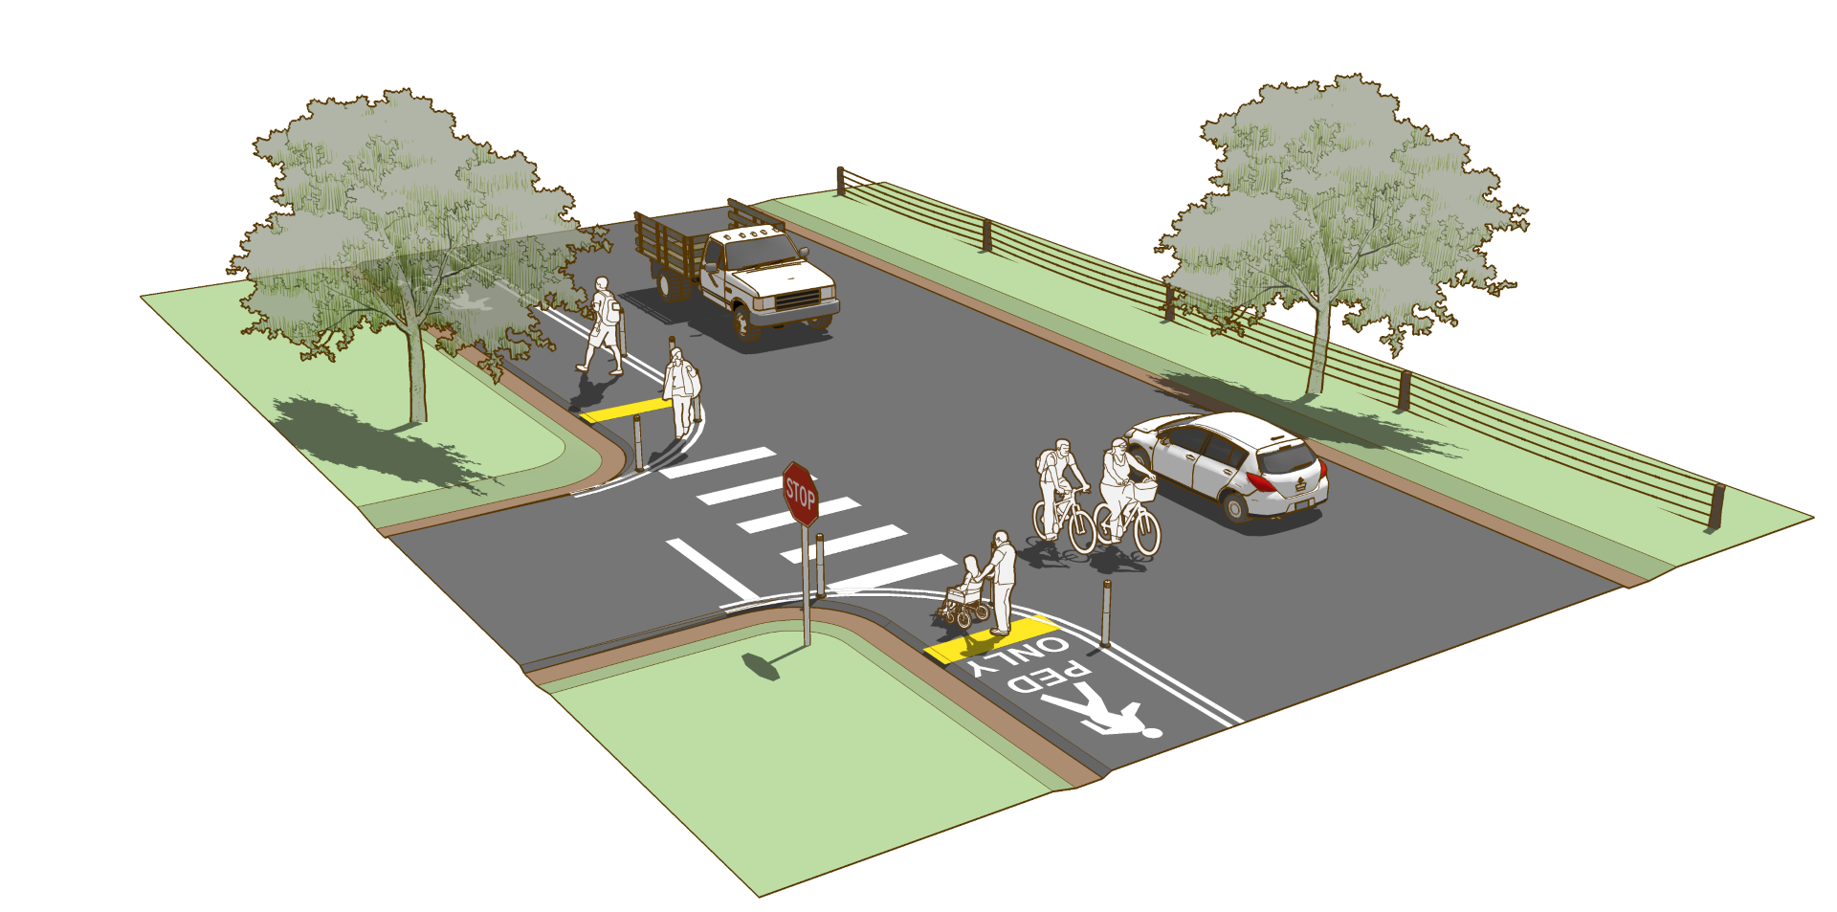
Pedestrian Lane
Experimental Treatment
Dedicated pedestrian space on roadway
Recommended as interim solution
Not shared with bicycles
ON STREET

Slide 21
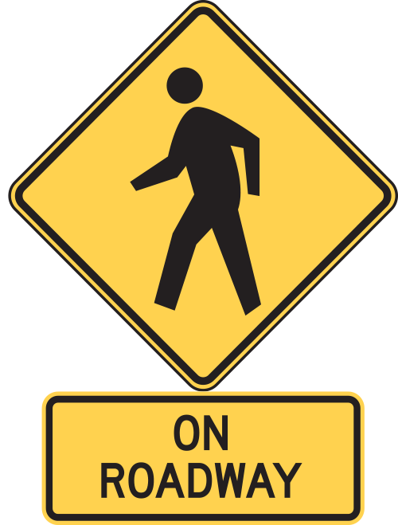
Pedestrian Lane
Double Solid Line
Must meet ADA for cross-slope, detectable warnings
Must meet PROWAG for running slope
W11-2 plus “ON ROADWAY” sign recommended
Flexible delineators suggested at cross streets to prevent encroachment by turning vehicles
W11-1 Sign Assembly
High Visibility Crosswalk
Bicyclists Use Roadway
Pedestrian
Lane Markings
ON STREET

Slide 22
Bike Lane
Dedicated Space
Width
4’ min. to edge of pavement
5’ min. to face of curb
NACTO recommends 6’ to face of curb (NACTO)
Wider IF:
Adjacent to parking without buffer
On streets above 35mph
ON STREET

Slide 23
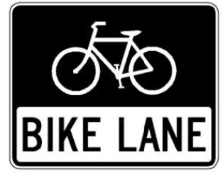
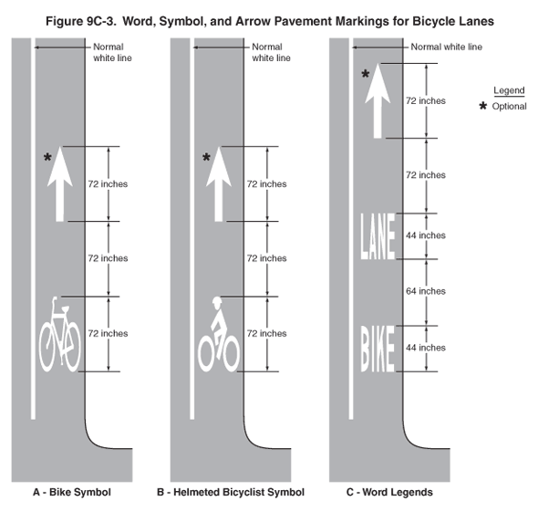
Bike Lane
Ideal Placement
25mph ≥ posted speed ≤ 35mph
3k ≥ ADT ≤ 10k
Required:
6” edge line adj. travel lane
Bike lane symbol
Optional:
4” edge line adj. gutter or edge of pavement
Signs to supplement pavement markings
ON STREET

Slide 24
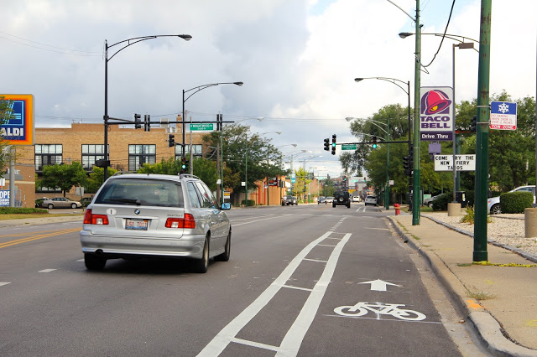
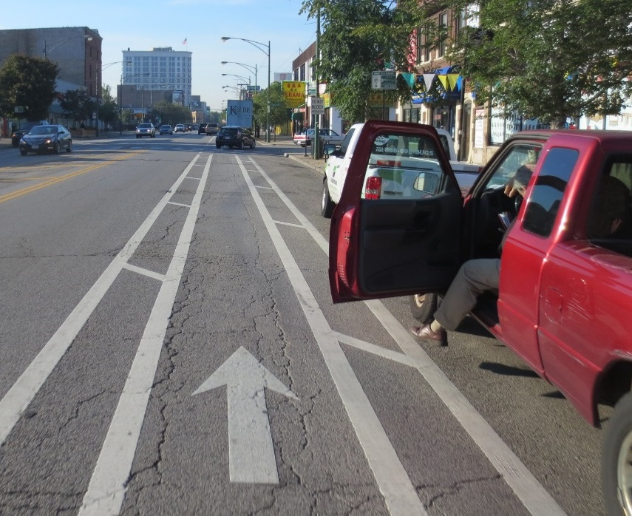
Buffered Bike Lane
Buffer:
1.5’ minimum, 2’ typical
Hatch recommended if 3’ or wider
30-45 degree angle
10-40’ spacing (CDOT uses 20’)
Posted speed is a good rule of thumb
Parking side vs. travel side
Which hazard is more likely
If you have room, add both
ON STREET

Slide 25
Buffered Bike Lane
Organizes roadway space
Bike lanes wider than 6’ begin to look like parking or travel lanes
Heavy vehicle-friendly
The benefits of a 12’ lane without encouraging speeding
Crash mitigation
Helps keep bicyclists out of dooring crash zone
ON STREET

Slide 26
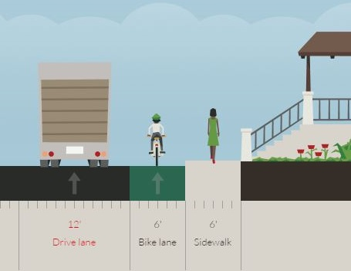
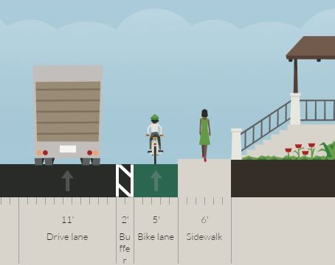
Buffered Bike Lane
2.8’
4.3’
12’ Travel
6’ Bike
6’ Walk
12’ Travel
2’
5’ Bike
6’ Walk
ON STREET
Notes:
Note how the addition of a buffer helps improve channelization without doing anything else. This can be helpful when you are in a state or city with a 4’ minimum passing distance law on the books (like Illinois)

Slide 27
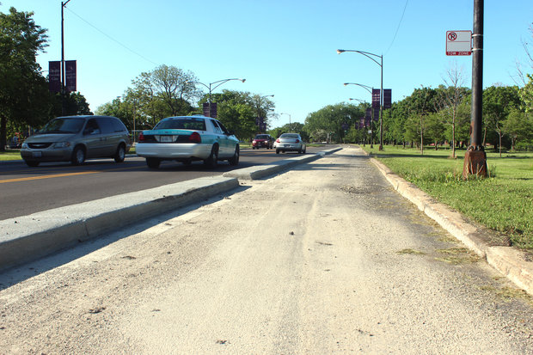
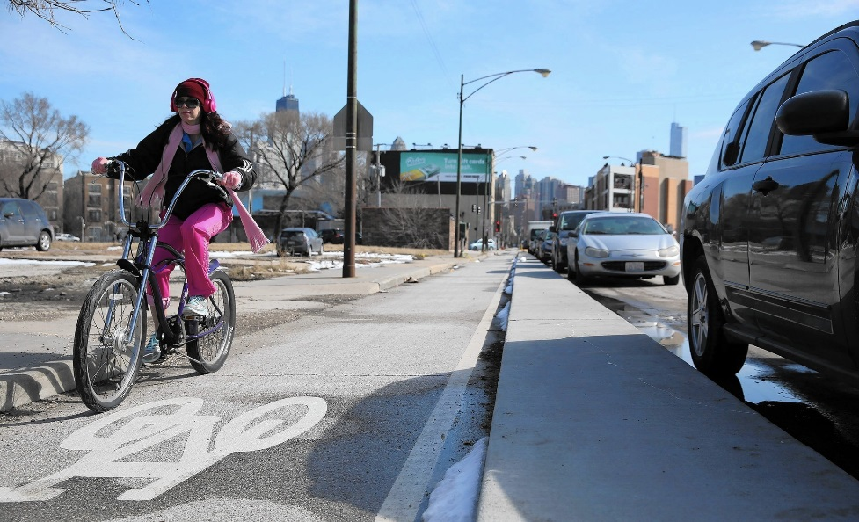
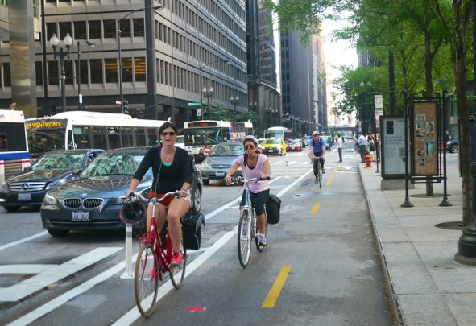
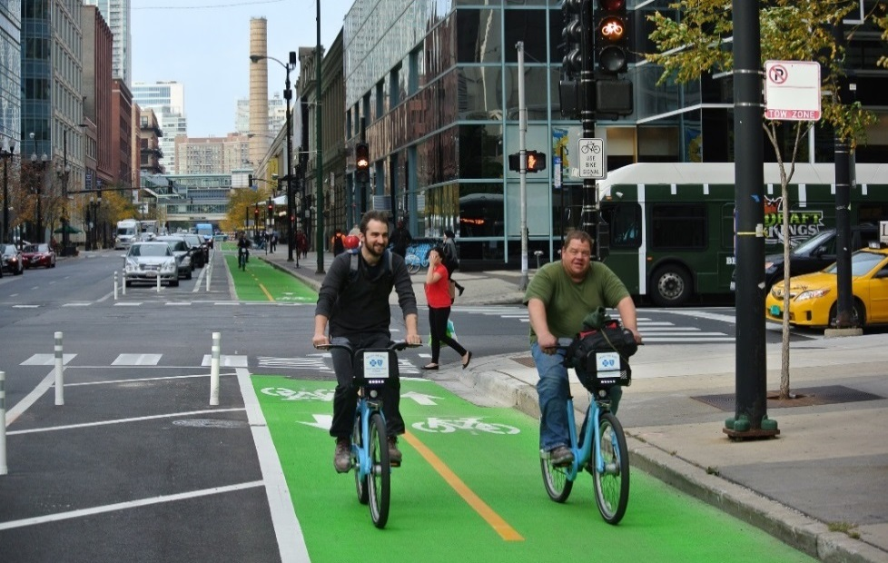
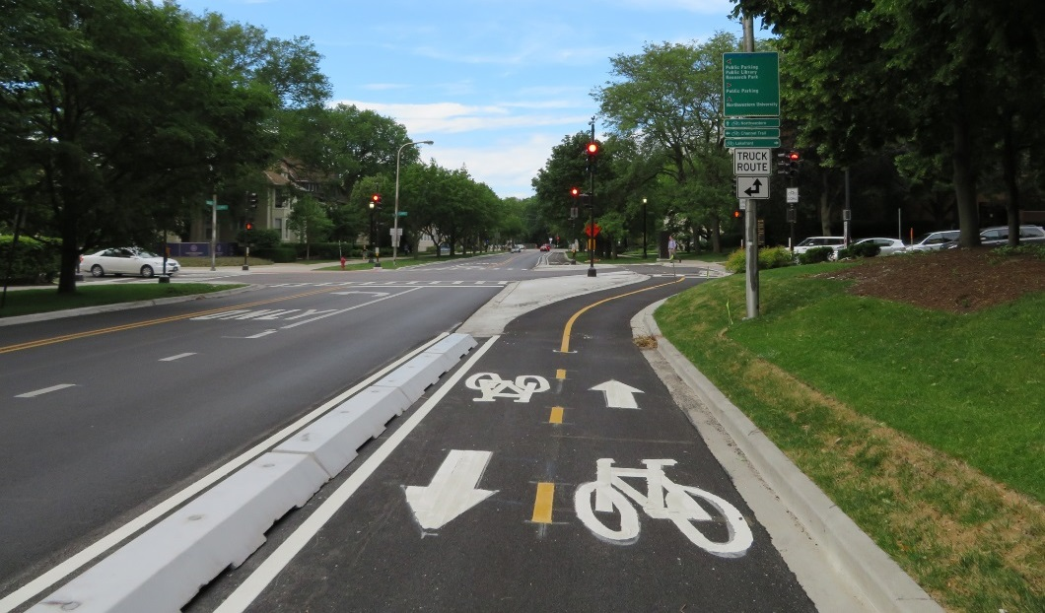
Separated Bike Lane
ON STREET
Notes:
AKA Cycle Tracks – explain the terminology (history of the use of “protected” versus separated)
Top Row: One-way, separated bike lanes, from left: Douglas Park, Chicago; Clybourn Avenue, Chicago; Clybourn Avenue, Chicago
Bottom Row: Two-way, separated, from left: Dearborn Street, Chicago; Clinton Street, Chicago; Chicago Avenue, Evanston.

Slide 28
Separated Bike Lane
Vertical element separating bike lane from everything else
Parking
Barrier curb
Mountable curb
Median, planters
Flexible delineators*
MUTCD Guidance?
Not exactly
Bicycle facility geometric guidance is based on preferential lane treatment (AASHTO), and thus not governed by MUTCD
ON STREET
Notes:
*

Slide 29
Separated Bike Lane One-Way
Best Resource? FHWA Separated Bike Lane Planning and Design Guide
ON STREET
Notes:
*This shows a two-page spread of separation guidance, including spacing of curbs, delineators, or both.

Slide 30
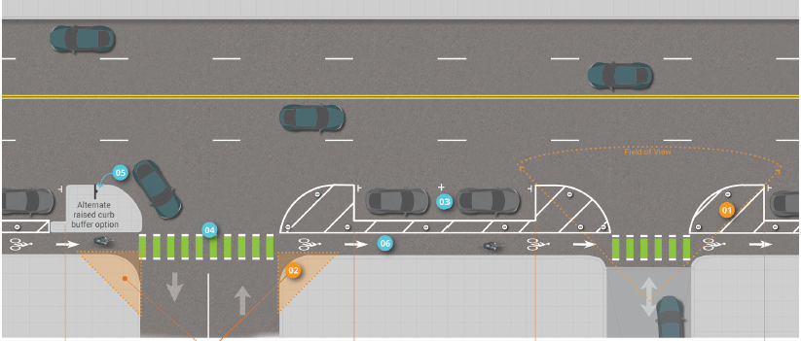
Separated Bike Lane One-Way
2’ spacing (4’ C-C)
vs.
6’ spacing (8’ C-C)
Green dash conflict marking: 2’ x 6’ bars (5.5’ green bar, 6” dotted white line, 2’ dash)
4’ C-C typ.
Curb vs. Pavement Marking
20’ min. parking restriction
15’ min. clear visual sign triangle
ON STREET
Notes:
2’ spacing, reminiscent of high-visibility pedestrian crosswalk markings, were typical at the time of creation of the FHWA guide. However, since that time, IA interpretation of green pavement markings for conflict zones has relaxed the spacing, resulting in 6’ spacing (and yielding material cost savings)

Slide 31
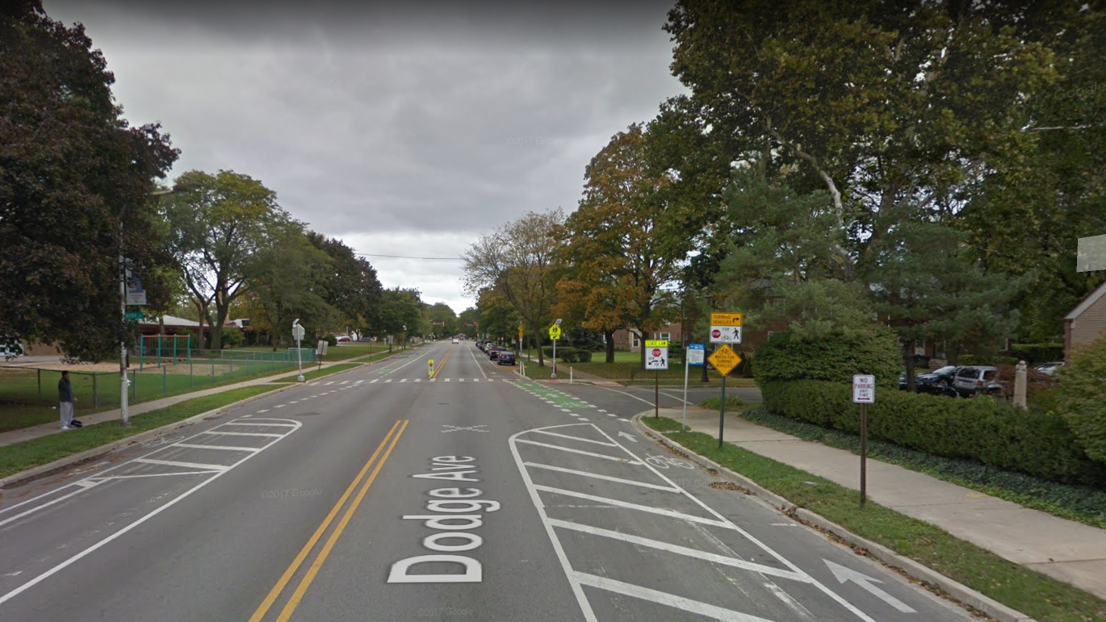
Notes:
Dodge Avenue, looking north approaching Kirk Street
Evanston, IL
Source: Google Street View

Slide 32
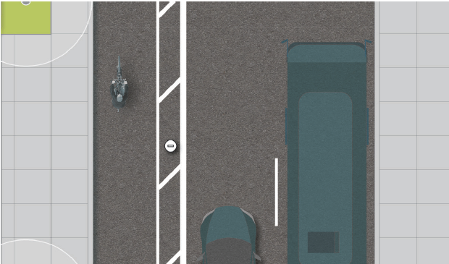
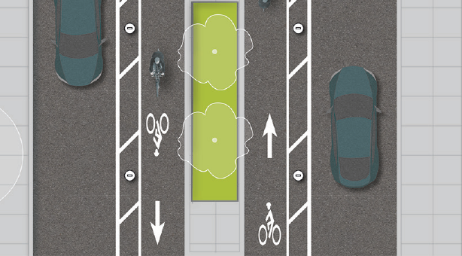
Separated Bike Lane One-Way
Provides high quality, low-stress facility
Requires more space than conventional bike lanes
Creative interpretation of preferential lane design
Wait, why is the bike lane on the left side?
ON STREET
Notes:
Good question: let’s get into this…

Slide 33
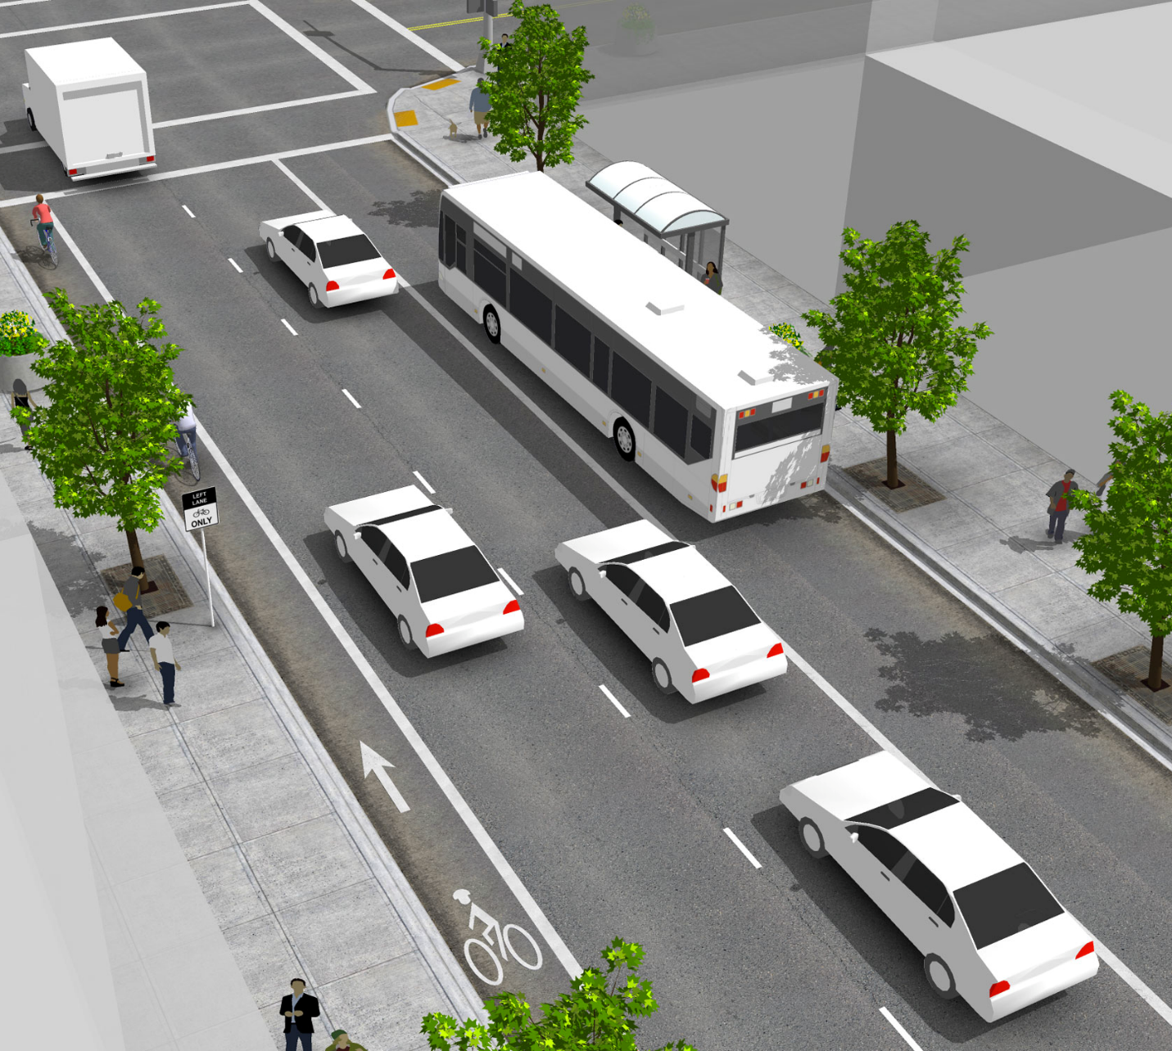
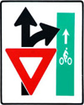
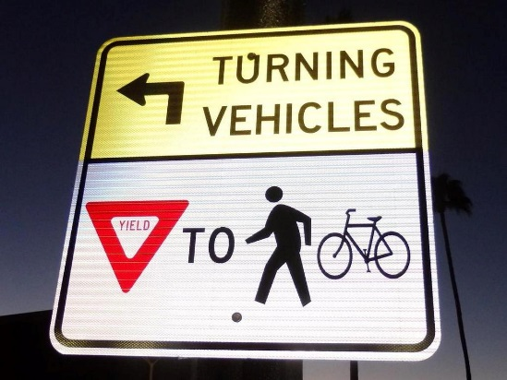
Left Side Bike Lane
R1-5a variant*
R10-15
R3
Required:
5’ min. width, 6’ desired
6” edge line, bike lane symbol
Optional:
Left Lane Bike Lane Only
Recommended:
Use two-stage turn boxes and/or signal separation for turns
Variations on R10-15 sign
“Left Turn Yield to Bikes” sign since this is a novel application
ON STREET

Slide 34
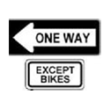
Contra-flow Bike Lane
R6-1 w/plaque
W6-3
Also helps accommodate wrong-way riding
Required:
Double yellow
One-way except bikes (R6-1)
Bike lane word, symbol, or arrow (MUTCD 9-3 assembly)
Signals
Optional:
Two-way warning sign (W6-3)
ON STREET

Slide 35
ON STREET
Notes:
So let’s review the building blocks of a typical midblock section that includes a contraflow bike lane.
Essentially a two-way street
Contraflow bike lane is basically where an opposing lane of traffic would be on any typical two-way street.
Left side placement mimics this, reducing potential conflicts to the same kind you would experience on any other two-way street (except that bicyclist speed, visibility, vulnerability are different)

Slide 36
ON STREET

Slide 37
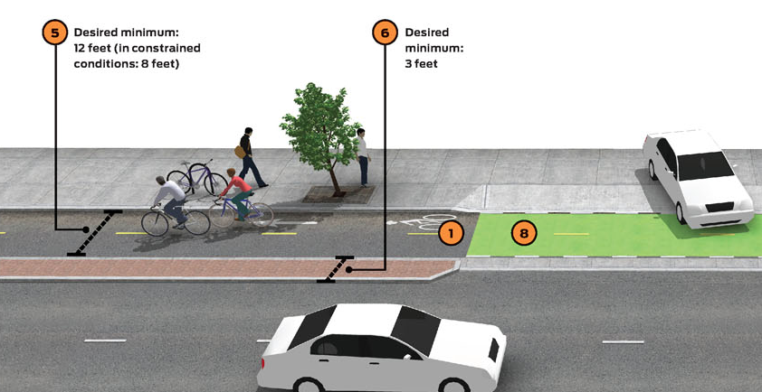
Separated Bike Lane Two-Way
8-12’ bikeway, 3’ buffer (min.)
Separation (curb, cars, delineators)
ON STREET

Slide 38
Dearborn Street, Chicago
Sheridan Road, Evanston
ON STREET

Slide 39
Bike Lane = 7’
Buffer = 4’
Minimum Clear Width = 9.5’
Bike Lane = 7.5’
Minimum Clear Width = 7.5’
ON STREET

Slide 40
On Street, Intersection (and Midblock)
Shared Right Turn and Bike Lane
Through Bike Lane
Bend In
Bend Out
Bike Box
Two-stage Turn Box
Protected Intersection
Intersection Crossing Markings*
Bike Signals
Mini Traffic Circle*
Roundabout
Median Refuge Island*
*Neighborhood Greenway
ON STREET

Slide 41
Shared Right Turn Lane / Bike Lane
Places bike lane within alignment of a right-turn lane
Eliminates lateral shift for one user group (bicyclists)
Keeps bicyclist aligned left of where a right-turn conflict would arise
ON STREET

Slide 42
Shared Right Turn Lane / Bike Lane
55th Street, Chicago, IL
Billings, MT
ON STREET
Notes:
Design on the right also may be referred to as a mixing zone.

Slide 43
Shared Right Turn Lane / Bike Lane
Required
Bicycle symbol to clarify intended position
9’ min. width, 13’ max.
BDE/BLRS: Aux. lanes ≥ 10’
Optional
Dashed line
Shared lane
Right turn only (R3-5r)
ON STREET

Slide 44
Through Bike Lane
Lane continuity important
Channelizes movements
Eliminates right hook conflict
Clarifies yielding responsibility
Required
Edge line
Bike lane symbol
Optional
Skip dash (2’ dash, 6’ space)
Signage R4-4, R3-7R
Green Pavement
ON STREET

Slide 45
Bend In
Bike lane bends in, toward travel lane.
Places users closer to each other before turn.
Note the lack of exclusive right turn lane.
ON STREET
Notes:
Works well in lower speed (30 mph or slower) environments.
Signalized or unsignalized
Consider “Right turn yield to bikes” sign (modified R10-15)

Slide 46
Bend Out
Bike lane bends out, away from travel lane.
Separates automobile turning movement from bike crossing movement.
ON STREET
Notes:
Works well with higher speed environments (35mph)
Ideal bend out provides one car length of storage between travel lane and bike crossing.
Consider “Right turn yield to bikes” sign (modified R10-15)
Discuss whether you would want a bend out adjacent to a right-turn lane?

Slide 47
Bend In vs. Bend Out
 | Pros | Cons
Bend In | Motorists more likely to see bicyclists in adjacent lane. Requires less space than a bend out. Can be done with or without curb work. | May require removal of one or two on-street parking spaces. Less robust separation can be stressful for some roadway users.
Bend Out | Allows turning motorist to get out of the travel lane before crossing the bike lane (reducing the occurrence of a rear end crash) Facilitates a two-stage left turn for bicyclists. If done with curb improvements, creates a pedestrian refuge, traffic calming effect. | Requires more space than a bend in (typically) Construction of curb work more costly, impact drainage, etc. Be careful to avoid cluttering the refuge, impacting sight lines.
ON STREET
Notes:
Works well with higher speed environments (35mph)
Ideal bend out provides one car length of storage between travel lane and bike crossing.
Discuss whether you would want a bend out adjacent to a right-turn lane?

Slide 48
Bike Box
Modified interpretation of a setback stop bar.
Provides room for groups of bicyclists to queuing at signalized intersections.
Doesn’t really facilitate left turns
ON STREET

Slide 49
Two-stage Turn Box
ON STREET

Slide 50
Bike Box
If you are trying to accommodate left turns, consider the bike box as a modification to the left turn lane.
Works well at signalized left turns or FYA conditions.
Less stressful than merging left to turn (re: AASHTO guidance).
ON STREET
Notes:
Left turns in mixed traffic are stressful, even more so if there is no exclusive left turn lane.
Early uses of bike boxes involved uphill grades, signalized intersections, and predictable wait times.

Slide 51
Two-stage Turn Box
Green pavement marking that shadows another lane group at a signalized intersection.
Splits a left turn into two movements.
Less stressful than moving left.
ON STREET

Slide 52
Two-stage Turn Box
Can shadow a parking lane or travel lane on the cross street.
Requires no turn on red (R10-11) condition to mitigate turning conflicts
Currently an experimental treatment (MUTCD 1A.10)
ON STREET

Slide 53
Two-stage Turn Box
Legitimizes a defensive bicyclist movement
ON STREET

Slide 54
ON STREET

Slide 55
Protected Intersection
Each user group’s path is channelized
Turning conflicts are mitigated through:
Reduced turning radii
Lower speeds
Shorter crossing distances / exposure times
ON STREET

Slide 56
Protected Intersection
Partial protection works, too.
One or more legs of an intersection
One or more movements through an intersection
ON STREET

Slide 57
Intersection Crossing Markings
Clarify (and anchor) bicyclist and motorist paths through an intersection.
Especially helpful if there is a lateral shift or horizontal curve.
Green pavement recommended to highlight conflict / crossing / weaving segments
ON STREET

Slide 58
Intersection Crossing Markings
ON STREET

Slide 59
Bike Signals
Subject to Interim Approval (IA-16)
Provide exclusive phase for bicycle movement
Required on two-way, separated bike lanes or contraflow facilities
ON STREET

Slide 60
Bike (or Traditional) Signals
If using pavement detection, consider pavement markings and loop detector design to accommodate bikes
ON STREET

Slide 61
Beacons (and other Xing support)
IF you have a midblock crossing location and…IF you have determined the need for beacons*
Consider:
RRFB
HAWK
Pedestrian actuated
Complements other treatments
ON STREET

Slide 62
Beacons (and other Xing support)
Crossing warning signage (W11 series)
Assigns priority to path crossing users (warning signage)
Education and periodic enforcement recommended
Stop or yield on path
Smaller than roadway application
MUTCD Section 2B, subject to engineering judgment
ON STREET

Slide 63
Beacons (and other Xing support)
Crossing angle matters, too
Use curves to improve alignment and also slow approaching path users
Aim for right angles
Supplement with warning signs
ON STREET

Slide 64
Mini Traffic Circle
Neighborhood-scale intersection element
Min. 15’ curb-to-circle width
Recommended in low-speed (25mph and below)
Can be enhanced with signage, pavement markings
Branded as a bicycle boulevard or neighborhood greenway
ON STREET

Slide 65
Roundabout
Two options, both involve termination of on-street bike lane:
End bike lane, transition to shared lane, circulate single file with traffic
Slip ramp onto sidewalk, widen sidewalk to shared use path (8-10’ typ.)
Shared lane yield to bikes sign common
ON STREET

Slide 66
Median Refuge Island
Barrier curb (or painted) median, provides room for crossing one lane or lane group at a time
IDOT draft application guidance based on speed, volume, and number of lanes
Also informs when to supplement with signage, pavement markings, beacons
ON STREET
Notes:
Note: The median refuge island has a crash modification factor (CMF) of 49%, relatively high. Sidewalks are 89%, among the highest CMF available.

Slide 67
Neighborhood Greenway
Roadways that prioritize bicycle travel
Uses traffic calming to keep motor vehicle speeds and volumes at a suitable level
≤ 3,000 ADT (≤ 1,500 preferred)
≤ 25 mph (≤ 20 mph preferred)
Run parallel to a busy/stressful/direct route
Maintains network connectivity
ON STREET

Slide 68
Neighborhood Greenway
ON STREET
Notes:
NACTO explains the reasoning behind the speed and volume thresholds, but FHWA, AASHTO, and ITE have been providing bike boulevard geometric, pavement marking, and signage guidance for a while.

Slide 69
Neighborhood Greenway
Reorient Stop Signs
Speed Humps
Curb Extensions
Partial Closures
Median Diverters
Neighborhood Easements
ON STREET
Notes:
In order:
Reorient stop signs (Portland, OR)
Speed humps (ASCE guidance)
Curb extension (Chicago, IL)
Partial closure (Portland, OR)
Median diverter (Portland, OR)
Neighborhood easement (Northbrook, IL)

Slide 70
Neighborhood Greenway
ON STREET
Notes:
In order:
Allen-Covenanter Greenway

Slide 71
Off Street – Shared Use Path
10’ minimum, 12’ preferred
8’ acceptable for short distances
A narrow segment is better than a gap
Stripe your shoulders and edge lines if you have high ADT or need to separate bicycle and pedestrian conflicts
Otherwise, save a little $ on the project
OFF STREET

Slide 72
Off Street – Shared Use Path
2ft. min
Path: 10’
Shoulder: 2’
2ft. min
OFF STREET

Slide 73
Off Street – Sidepath
A sidepath is a shared use path that is within 5’ of a roadway, rail, or waterway edge.
AASHTO (and IDOT BDE) recommend 5’ minimum separation from traffic
Wider separation may be needed adjacent to rail, steep grade changes,
OFF STREET
Notes:
Image source: Lake County Division of Transportation / TrailLink.net
AASHTO is still the most comprehensive source for shared use path design, because not much has changed
- Where the biggest changes in guidance have occurred are at intersections. Refer to FHWA, NACTO, IDOT, and ITE for good guidance (specifically: bend in vs. bend out, crossing treatments, contextual guidance)

Slide 74
Off Street –Transitions
OFF STREET
Notes:
Note: this is mostly geometric improvements with some signs and pavement markings.
Image source (1): MassDOT Separated Bike Lane Planning & Design Guide
Image source (2): FHWA Small Town and Rural Multimodal Networks Guide

Slide 75
Questions + Discussion
Thank You
Tim Gustafson, AICP | tgustafson@epsteinglobal.com | 312-429-8054

